Slide 1

Middle School at Arrowcreek
Special Use Permit

Slide 2

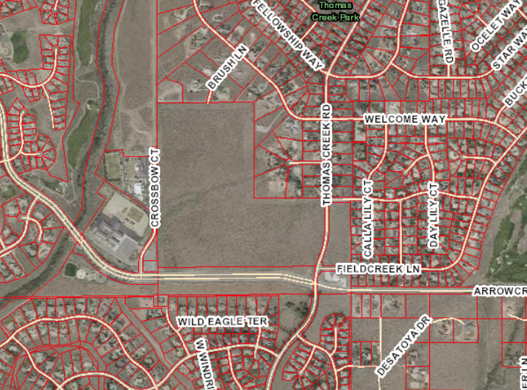

Project Background
U.S. Forest Service – Education Land Grant Act
60 acres of land
Environmental Assessment (EA) process
Public input process
USFS – Decision Notice

Slide 3
Questions?

Slide 4


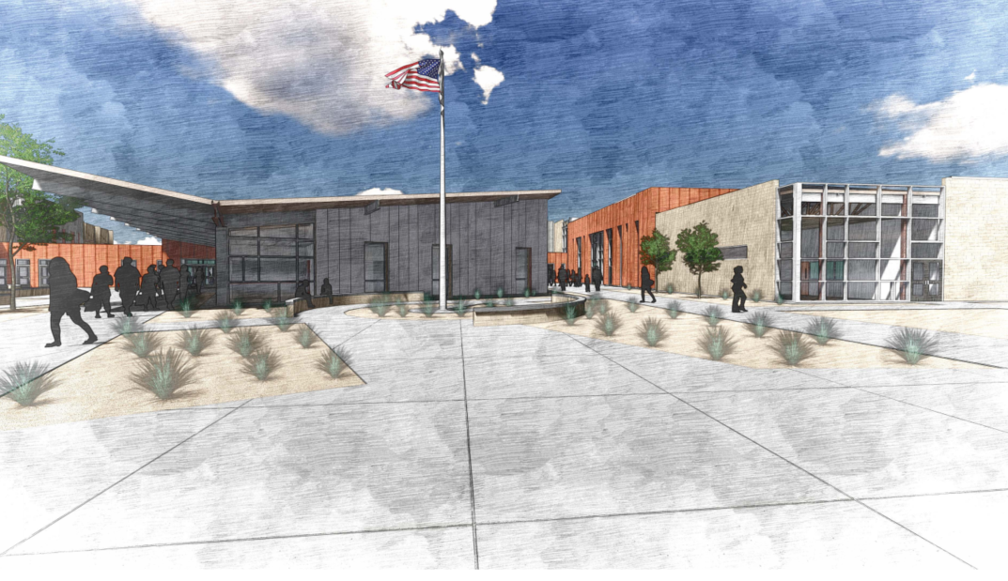
Middle School
at Arrowcreek

